Slide 1
Voltage and Current
Session 2-3
SCIE6063
COMPUTATIONAL PHYSICS
June 2024

Slide 2
Electric Potential

Slide 3
Experimentally, physicists and engineers discovered that the electric force is conservative and thus has an associated electric potential energy.
The motivation for associating a potential energy with a force is that we can then apply the principle of the conservation of mechanical energy to closed systems involving the force.

Slide 4
1. Electric Potential Energy
When an electrostatic force acts between two or more charged particles within a system of particles, we can assign an electric potential energy U to the system.
If the system changes its configuration from an initial state i to a different final state f, the electrostatic force does work W on the particles. If the resulting change is ΔU,
ΔU = U_{f} –U_{i} = -W
As with other conservative forces, the work done by the electrostatic force is path independent.
Usually the reference configuration of a system of charged particles is taken to be that in which the particles are all infinitely separated from one another. The corresponding reference potential energy is usually set be zero. Therefore,
U = -W∞

Slide 5
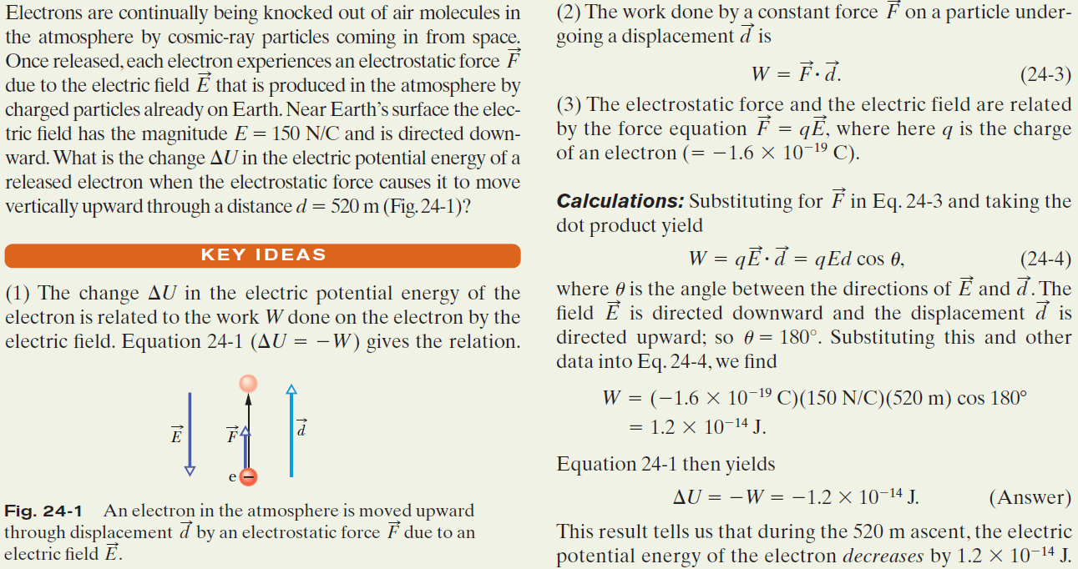
Example, Work and potential energy in an electric field:

Slide 6



2. Electric Potential
The potential energy per unit charge at a point in an electric field is called the electric potential V (or simply the potential)
at that point. This is a scalar quantity. Thus,
The electric potential difference V between any two points i and f in an electric field is equal to the difference in potential energy per unit charge between the two points. Thus,
The potential difference between two points is thus the negative of the work done by the electrostatic force to move a unit charge from one point to the other.

Slide 7

Electric Potential (cont.)

Slide 8
Electric Potential (cont.)
This unit of volt allows us to adopt a more conventional unit for the electric field, E, which is expressed in Newton per Coulomb (N/C).
We can now define an energy unit that is a convenient one for energy measurements in the atomic/subatomic domain:
One electron-volt (eV) is the energy equal to the work required to move a single elementary charge e, such as that of the electron or the proton, through a potential difference of exactly one volt.
The magnitude of this work is qΔV, and
1 eV= e(1V)=(1,60x10⁻¹⁹C)(1 J/C) = 1,60x10⁻¹⁹ J

Slide 9




Electric Potential (cont.)
Work done by an Applied Force:
If a particle of charge q is moved from point i to point f in an electric field by applying a force to it, the applied force does work W_{app} on the charge while the electric field does work W on it. The change K in the kinetic energy of the particle is
If the particle is stationary before and after the move, Then K_{f} and K_{i} are both zero.
Relating the work done by our applied force to the change in the potential energy of the particle during the move, one has
We can also relate W_{app} to the electric potential difference ΔV between the initial and final locations of the particle:

Slide 10




4. Calculating the Potential from the Field
Path
For the situation of Fig. 3,
Total work:
field line
i
ds
q₀E
f
Fig.3. A test charge q₀ moves from point i to point f along the path shown in nonuniform electric field. During a displacement ds, an electrostatic force q₀E acts on the test charge. This force points in the direction of the field line at the location of the test charge.

Slide 11

Calculating the Potential from the Field (cont.)

Slide 12
5. Potential Due to a Point Charge
E
A positively charged particle produces a positive electric potential.
A negatively charged particle produces a negative electric potential.
Consider a point P at distance R from a fixed particle of positive charge q. Imagine that we move a positive test charge q₀ from point P to infinity. The path chosen can be the simplest one a line that extends radially from the fixed particle through P to infinity.
ds
q₀
.
P
R
q
Fig.4. The positive point charge q produces an electric field E and an electric potential V at point P. We find the potential by moving a test charge q₀ from P to infinity. The test charge is shown at distance r from the point charge, during differential displacement ds

Slide 13





Potential Due to a Point Charge (cont.)

Slide 14

6. Potential Due to a Group of Point Charges:
The net potential at a point due to a group of point charges can be found with the help of the superposition principle.
First the individual potential resulting from each charge is considered at the given point. Then we sum the potentials.
For n charges, the net potential is

Slide 15
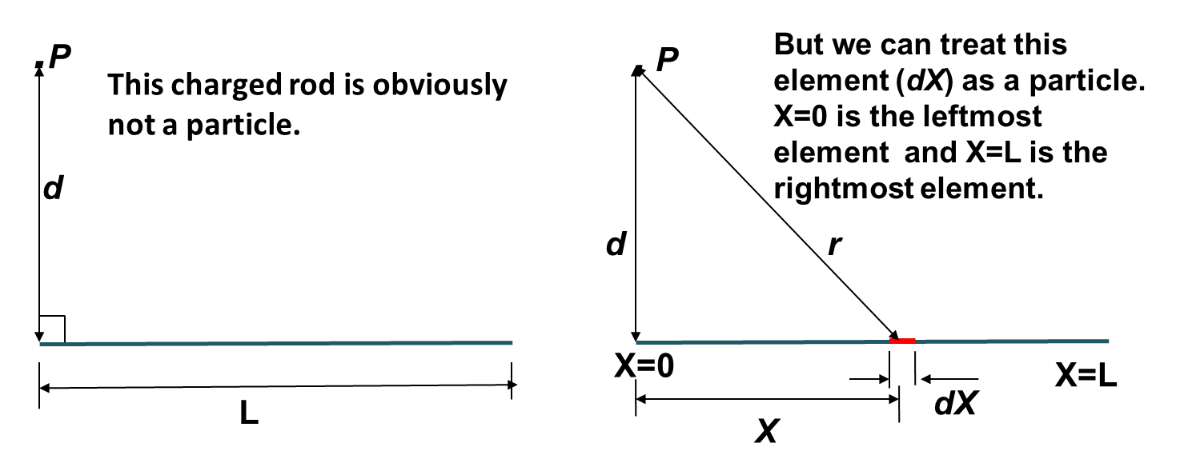
Potential Due to a Continuous Charge
Distribution
Fig. 6 (a) A thin, uniformly charged rod produces an electric potential V at point P. (b) An element (dX) can be treated as a particle.
The potential at P due to the element depends on the distance r. We need to sum the potentials due to all the elements, from the left side (X=0) to the right side (X=L).

Slide 16



Potential Due to a Continuous Charge Distribution (cont.)

Slide 17
9. Calculating the Field from the Potential:
E
Suppose that a positive test charge q₀ moves through a displacement from one equipotential surface to the adjacent surface. The work the electric field does on the test charge during the move is -q₀ dV.
S
θ
q₀
ds
Two equipotensial surfaces
Fig.8. A test charge q₀ moves a distance ds from one equipotential surface to another (the separation between the surfaces has been exaggerated for clarity). The displacement ds makes angle θ with the direction of the electric field E

Slide 18




Slide 19


Slide 20
10. Electric Potential Energy of a System of Point Charges
The electric potential energy of a system of fixed point charges is equal to the work that must be done by an external agent to assemble the system, bringing each charge in from an infinite distance.
q₁ q₂
+ r +
Fig. 9. shows two point charges q₁ and q₂, separated by a distance r.
When we bring q₁ in from infinity and put it in place, we do no work because no electrostatic force acts on q₁.
However, when we next bring q₂ in from infinity and put it in place, we must do work because q₁ exerts an electrostatic force on q₂ during the move.
Fig.9. Two charges held a fixed distance r apart

Slide 21


Electric Potential Energy of a System of Point Charges (cont.)

Slide 22
Electric Potential Energy of a System of Point Charges (cont.)
Example, Potential Energy of a System of Three Charged Particles:
Fig.10. shows three points of charge held in fixed positions by forces that are not shown. What is the electric potential energy U of this system of charges? Assume that d=12 cm and that q₁=+q, q₂=-4q. and q₃=+2q, in which q=150 nC.
q₂
Energy is associated with each pair of particles
d d
q₁
d
q₃

Slide 23
Electric Current

Slide 24
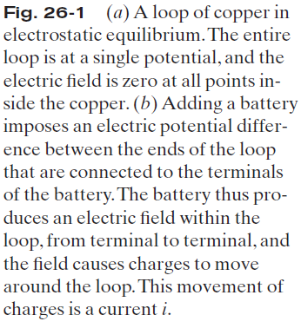
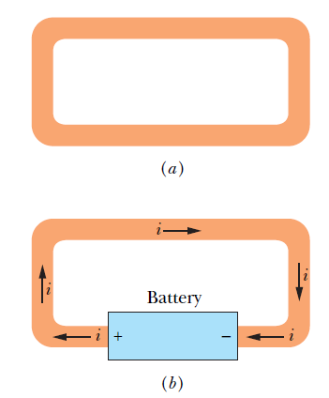
1. Electric Current:

Slide 25
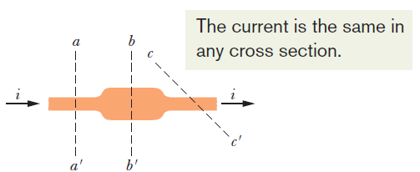

Electric Current (cont)
Fig.1. The current i through the conductor has the same value at planes aa’, bb’ , and cc’
The figure shows a section of a conductor, part of a conducting loop in which current has been established. If charge dq passes through a hypothetical plane (such as aa’) in time dt, then the current i through that plane is
defined as:

Slide 26

Electric Current (cont)
The charge that passes through the plane in a time interval extending from 0 to t is:
Under steady-state conditions, the current is the same for planes aa’, bb’, and cc’ and for all planes that pass completely through the conductor, no matter what their location or orientation.
The SI unit for current is the coulomb per second, or the ampere (A) : 1 ampere = 1 A = 1 coulomb per second = 1C/s

Slide 27

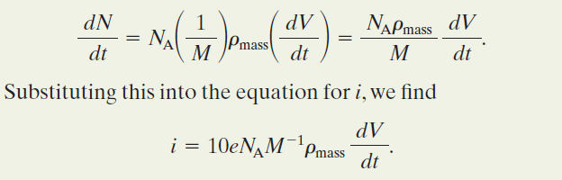
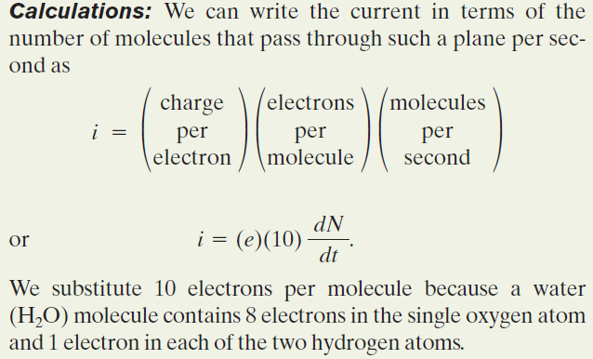
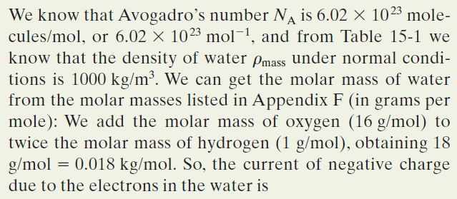
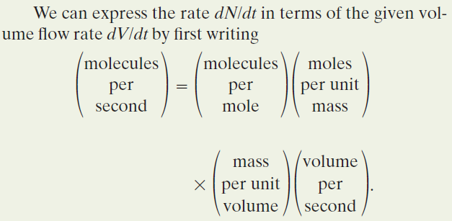
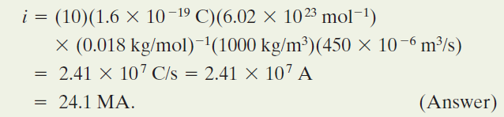
Example, Current is the Rate at which charge passes through a point:

Slide 28
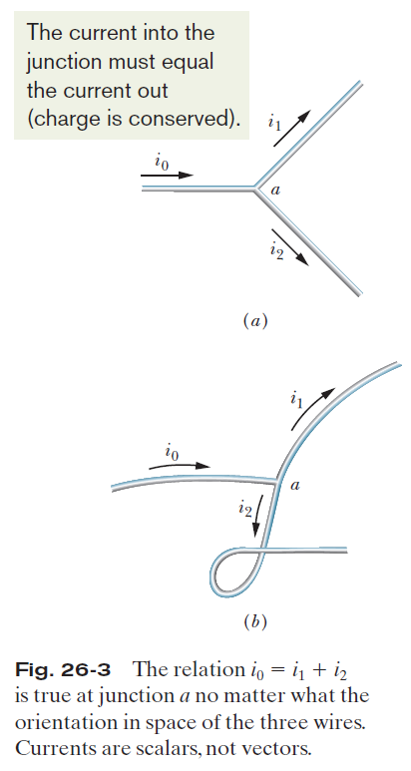
Electric Current (cont.)
A current arrow is drawn in the direction in which positive charge carriers would move, even if the actual charge carriers are negative and move in the opposite direction
Fig.2. The relation i₀ =i₁ + i₂ is true at junction a no matter what the orientation in space of the three wires. Currents are scalars, not vector

Slide 29


2. Current Density
The magnitude of current density, J, is equal to the current per unit area through any element of cross section. It has the same direction as the velocity of the moving charges if they are positive and the opposite
direction if they are negative.
If the current is uniform across the surface and parallel to dA, then J is also uniform and parallel to dA.
Here, A is the total area of the surface.
The SI unit for current density is the ampere per square meter (A/m²).

Slide 30
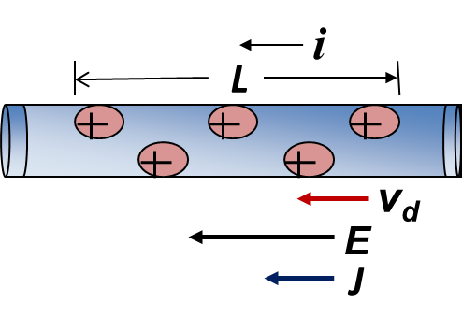
Current Density (cont.)
Fig.3. Positive charge carriers drift at speed V_{d} in the direction of applied electric field E. By convention, the direction of the current density J and the sense of the current arrow are drawn in that same direction.
When a conductor has a current passing through it, the electrons move randomly, but they tend to drift with a drift speed v_{d} in the direction opposite that of the applied electric field that causes the current.
The drift speed is tiny compared with the speeds in the random motion. In the figure, the equivalent drift of positive charge carriers is in the direction of the applied electric field, E.

Slide 31




Current Density (cont.)
The total charge of the carriers in the length L, each with charge e, is then : q = (nAL)e.
The total charge moves through any cross section of the wire in the time interval :

Slide 32
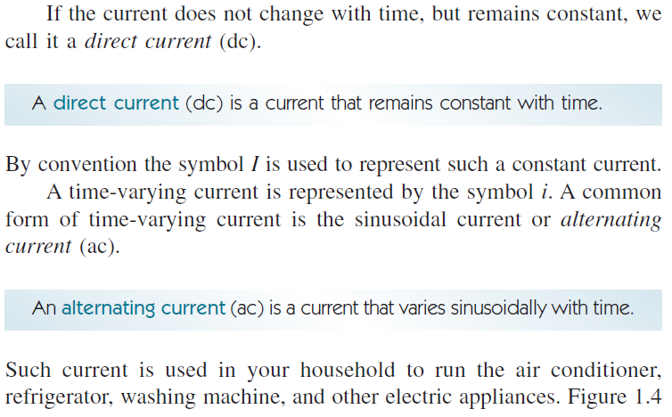
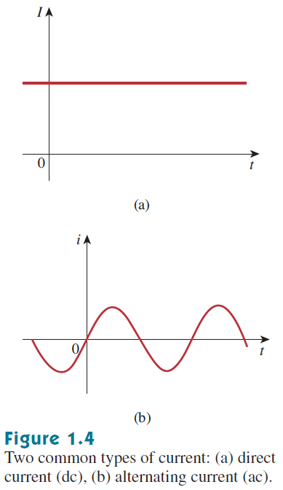
3. AC and DC Current
Alternators create AC power by spinning a wire loop inside a magnetic field. This wave-like motion means that AC power can travel farther than DC power, a huge advantage when it comes to delivering power to consumers via power outlets.

Slide 33
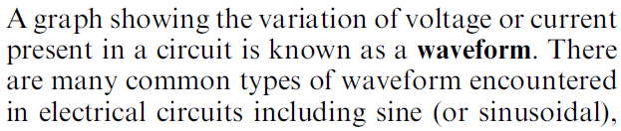
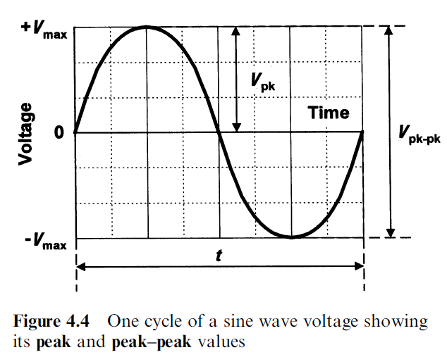
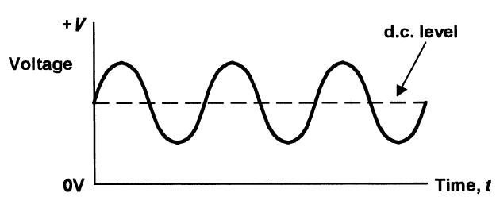
3. AC and DC Current
Historically, DC sources were the main means of providing electric power up until the late 1800s. At the end of that century, the battle of direct current versus alternating current began. Both had their advocates among the electrical engineers of the time. Because ac is more efficient and economical to transmit over long distances, ac systems ended up the winner.

Slide 34
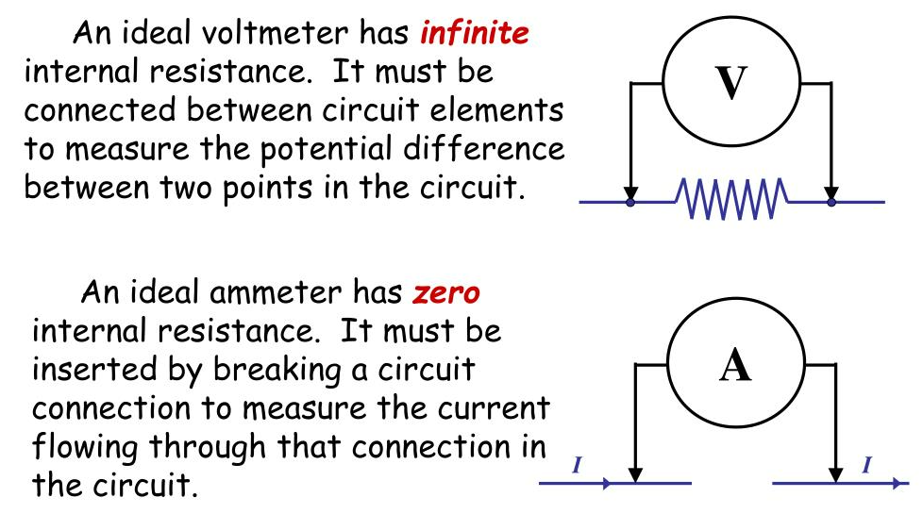
Ammeter and Voltmeter

Slide 35
These slides have been adapted from
Halliday D.; Resnick R. and Walker J. (2018). Fundamentals Of Physics ,Extended,
11th , John Wiley & SONS Inc, New York, ISBN: 9781119306856
Chapter 24

